Slide 1
MQTT
An IoT Protocol

Slide 2
Contents
History
Overview
MQTT Architecture
MQTT Roles
Message types
Quality of service (QoS)
Real-world applications

Slide 3
History
MQTT was invented by Andy Stanford-Clark (IBM) and Arlen Nipper (Arcom, now Cirrus Link) back in 1999, when their use case was to create a protocol for minimal battery loss and minimal bandwidth connecting oil pipelines over satellite connection.
After MQTT had been used by IBM internally for quite some times, version 3.1 was released royalty free in 2010.
OASIS ver 5 is latest standard. Highly Recommend to READ.

Slide 4
Overview
MQTT is an application layer protocol. It is light weight and easy to implement and run over well know TCP/IP stack. The Data link can be anything like wireless(802.15.4, wifi), Bluetooth (BLE)etc.
MQTT uses tcp port 1883 (unsecured) or 8883(secured), the broker listen to this port
First TCP connection by connecting to Broker’s IP address. After TCP MQTT connects at application layer protocol specific messages

Slide 5
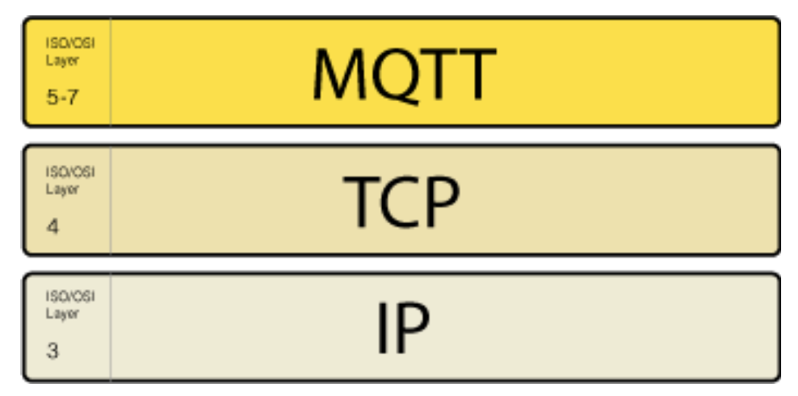
MQTT Stack

Slide 6
MQTT Pub/Sub Architecture
MQTT is based on Pub/Sub architecture, that mean it is asynchronous, sender and receiver does not have to be online at the same time.
MQTT provide time and space decoupling for sender and receiver of the message.
Three roles – Publisher, subscriber and Broker.

Slide 7
MQTT Pub/Sub Architecture
Publisher publishes to a topic
Subscriber subscribe to a topic
Broker listen to all the topic Published and relay the interested topic to subscriber which it ask for.
Broker can store published data if subscriber is not online.
MQTT provide QoS for messaging.

Slide 8
MQTT Subscriber

Slide 9
MQTT Publisher

Slide 10
MQTT Broker

Slide 11
Topics
UTF and string seprated by “/”. Topic can be nested, and wildcard can be used. The “/ “ is a topic too. However, wildcard is used only at subscriber.
Topic with $ sign at beginning mean un- subscribable; only broker can post to this topic used by admins. Broker keeps count of publishers/ subscriber by special topics.
Topics are case sensitive.
Topic example : sdn/IoT/MQTT
Notes:
Consider talking about:
Connect
Disconnect
Publish

Slide 12
Message types
Connect
Publish
Subscribe
Unsubscribe
Notes:
Consider talking about:
Connect
Disconnect
Publish

Slide 13
Quality of service (QoS)
At most once (0)
At least once (1)
Exactly once (2).

Slide 14
MQTT Install
Server - apt-get install mosquitto
Client - pip3 install paho-mqtt
Notes:
module: mqtt
short_description: Publish a message on an MQTT topic for the IoT
version_added: "1.2"
description:
- Publish a message on an MQTT topic.
options:
server:
description:
- MQTT broker address/name
required: false
default: localhost
port:
description:
- MQTT broker port number
required: false
default: 1883
username:
description:
- Username to authenticate against the broker.
required: false
password:
description:
- Password for C(username) to authenticate against the broker.
required: false
client_id:
description:
- MQTT client identifier
required: false
default: hostname + pid
topic:
description:
- MQTT topic name
required: true
default: null
payload:
description:
- Payload. The special string C("None") may be used to send a NULL
(i.e. empty) payload which is useful to simply notify with the I(topic)
or to clear previously retained messages.
required: true
default: null
qos:
description:
- QoS (Quality of Service)
required: false
default: 0
choices: [ "0", "1", "2" ]
retain:
description:
- Setting this flag causes the broker to retain (i.e. keep) the message so that
applications that subsequently subscribe to the topic can received the last
retained message immediately.
required: false
default: False
# informational: requirements for nodes
requirements: [ mosquitto ]
notes:
- This module requires a connection to an MQTT broker such as Mosquitto
U(http://mosquitto.org) and the I(Paho) C(mqtt) Python client (U(https://pypi.python.org/pypi/paho-mqtt)).
author: "Jan-Piet Mens (@jpmens)"
'''
EXAMPLES = '''
- local_action: mqtt
topic=service/ansible/{{ ansible_hostname }}
payload="Hello at {{ ansible_date_time.iso8601 }}"
qos=0
retain=false
client_id=ans001
'''
# ===========================================
# MQTT module support methods.
#
HAS_PAHOMQTT = True
try:
import socket
import paho.mqtt.publish as mqtt
except ImportError:
HAS_PAHOMQTT = False
# ===========================================

Slide 15
Real-world applications

